Slide 1

Home work Problems
CAPM/ Security Line

Slide 2
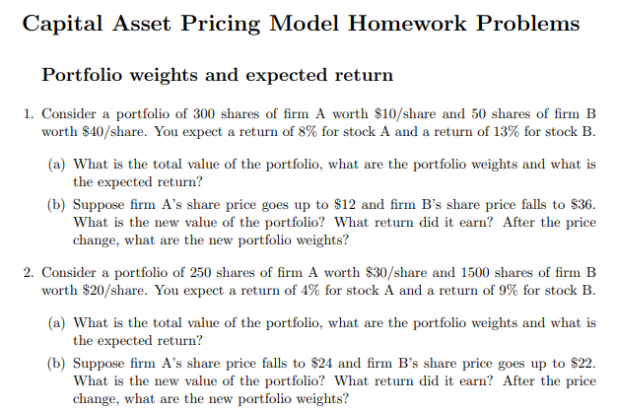

Slide 3
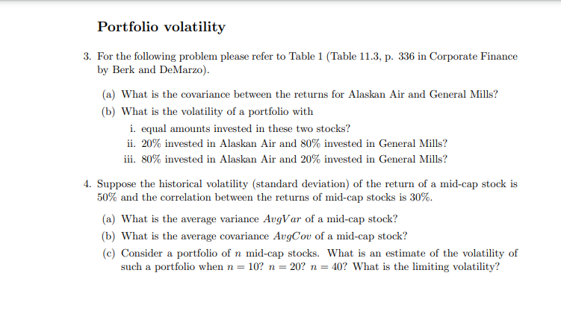

Slide 4
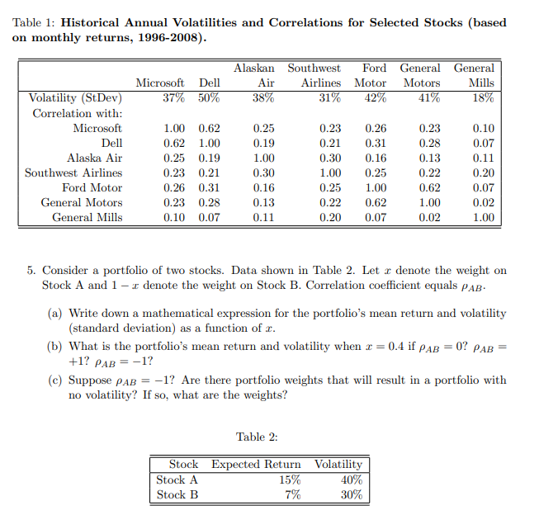

Slide 5
For each of the following probability distributions, calculate the expected value and standard deviation: A)
Outcome | Probability |  |  | Outcome value | px |  |  |  | x-E(x) | (x-E(x))² | p(x-E(x))²
Good | 30% |  |  | $40 |  | $12 |  |  | $16 | $256 | 77
Normal | 50% |  |  | $20 |  | $10 |  |  | -$4 | $16 | 8
Bad | 20% |  |  | $10 |  | $2 |  |  | -$14 | $196 | 39
 | 100% |  |  | E(x) = |  | $24 |  |  |  | variance = |  | 124
 |  |  |  |  |  |  |  |  |  | standard deviation = | $11

Slide 6
B,
Outcome | Probability | Outcome value | px |  |  | x-E(x) | (x-E(x))² | p(x-E(x))²
A | 10% | $1,000 | $100 |  |  | -$2,000 | 4,000,000 | 400,000
B | 20% | $2,000 | $400 |  |  | -$1,000 | 1,000,000 | 200,000
C | 40% | $3,000 | $1,200 |  |  | $0 | 0 | 0
D | 20% | $4,000 | $800 |  |  | $1,000 | 1,000,000 | 200,000
E | 10% | $5,000 |  | $500 |  | $2,000 | 4,000,000 | 400,000
 |  | E(x) = | $3,000 |  |  |  | variance = | 1,200,000
 |  |  |  |  |  |  | standard deviation = | $1,095

Slide 7
There is a 50% probability that the Plum Company's sales will be $10 million next year, a 20% probability that they will be $5 million, and a 30% probability that they will be $3 million.
What are the expected sales of Plum Company next year?
Expected value = $6.9 million
What is the standard deviation of Plum's next year's sales?
Variance = 4.8050 + 0.7220 + 4.5630 = 10.09
Standard deviation = square root of 10.09 = $3.1765 million

Slide 8
You want to win the Lottery? Good Luck! The odds of winning a $6 million lottery jackpot in Florida are 1 in 14,000,000. What is the expected value of a $1 lottery ticket investment?
Lottery ticket
E _{cash flow} = [0.0000000714 ($6,000,000)] + [0.9999999286 ($0)]
winning losing
= $0.43 + $0
=$0.43.
Spending $1 for a ticket with an expected value of 43c/ means that you expect to lose 57c/

Slide 9
Consider a portfolio comprised of four securities in the following proportions and with the indicated security beta.
Security | Amount invested | Beta | Expected return
A | $1.5 million | 1.0 | 12.0%
B | $1.0 million | 1.5 | 13.5%
C | $2 million | 0.8 | 9.0%

Slide 10
What is the portfolio's beta?
β_{p} = (1.5/4.5) 1.0 + (1/4.5) 1.5 + (2/4.5) 0.8
β_{p} = 0.3333 + 0.3333 + 0.3556 = 1.0222

Slide 11
B. What is the portfolio's expected return?
E(p) = (1.5/4.5)0.12 + (1/4.5) 0.135 +
(2/4.5) 0.09 E(p) = 0.04 + 0.03 + 0.04 = 0.11 or 11%.

Slide 12
ABC Company has a beta of 1.2. The expected risk-free rate of interest is 4% and the expected premium for the market as a whole is 5%. What is the expected return for ABC Company stock?
r= 4% + 1.2(5%) = 10%

Slide 13
Consider Securities D and E with the following estimates:
E(R_{D}) = 8% σ_{D}= 12% E(R_{E}) = 13% σ_{E} = 20%
Now consider the portfolios that can be formed with D and E, assuming that the investment is equal between D and E (that is, each has a weight of 50%). What is the portfolio’s standard deviation if the correlation between D and E for each of the following?
(a) r_{ij}=1.0

Slide 14
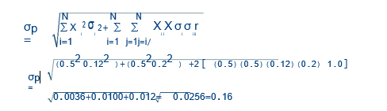

Slide 15

b).r_{ij} = 0.0

Slide 16
Consider Securities X and Y with the following estimates:
E(R_{X}) = 5% σ_{X}= 10% E(R_{Y}) = 15% σ_{Y} = 25%
If the portfolio is comprise of 40% X and 60% Y and if the correlation between the returns on X and Y is -0.25,
what is the portfolio’s expected return and risk?

Slide 17
Expected return = 0.4(0.05) + 0.6(0.15) = 0.02 + 0.09 = 0.11 or 11%
Variance = (0.4)(0.4)(0.10)(0.10) + (0.6)(0.6)(.25)(.25)+(2)(0.4)(0.6)(0.1)(0.25)(-0.25) Variance = 0.0016 + 0.0225+-0.0030 = 0.0211
Standard deviation = 14.5268%

